Slide 1
2022 and beyond, the brave new world and how the employment landscape is changing
Presented by Lisa Mackay
Notes:
KEY FOR THESE DELIVERY NOTES:
Italics: indicates an instruction
Normal: indicates text that is a script to be spoken, or amended to suit your presentation style *Click*: indicates an animation which will appear on a click.
Prior to conducting the webinar, practise delivering this presentation using your speaker notes. Both moderator and presenter need to practise.
Best practice is to set up the webinar at least 30 minutes before the start time so you can check sound, slide transitions and practise swapping controls from moderator to presenter and back.
Make sure the ‘How we can help you’ slide has been updated with your services and pricing and that you’ve removed any slides not relevant to you.
Be clear on how long the webinar should run for; how many minutes for your presentation and 5 minutes for Q&A.

Slide 2
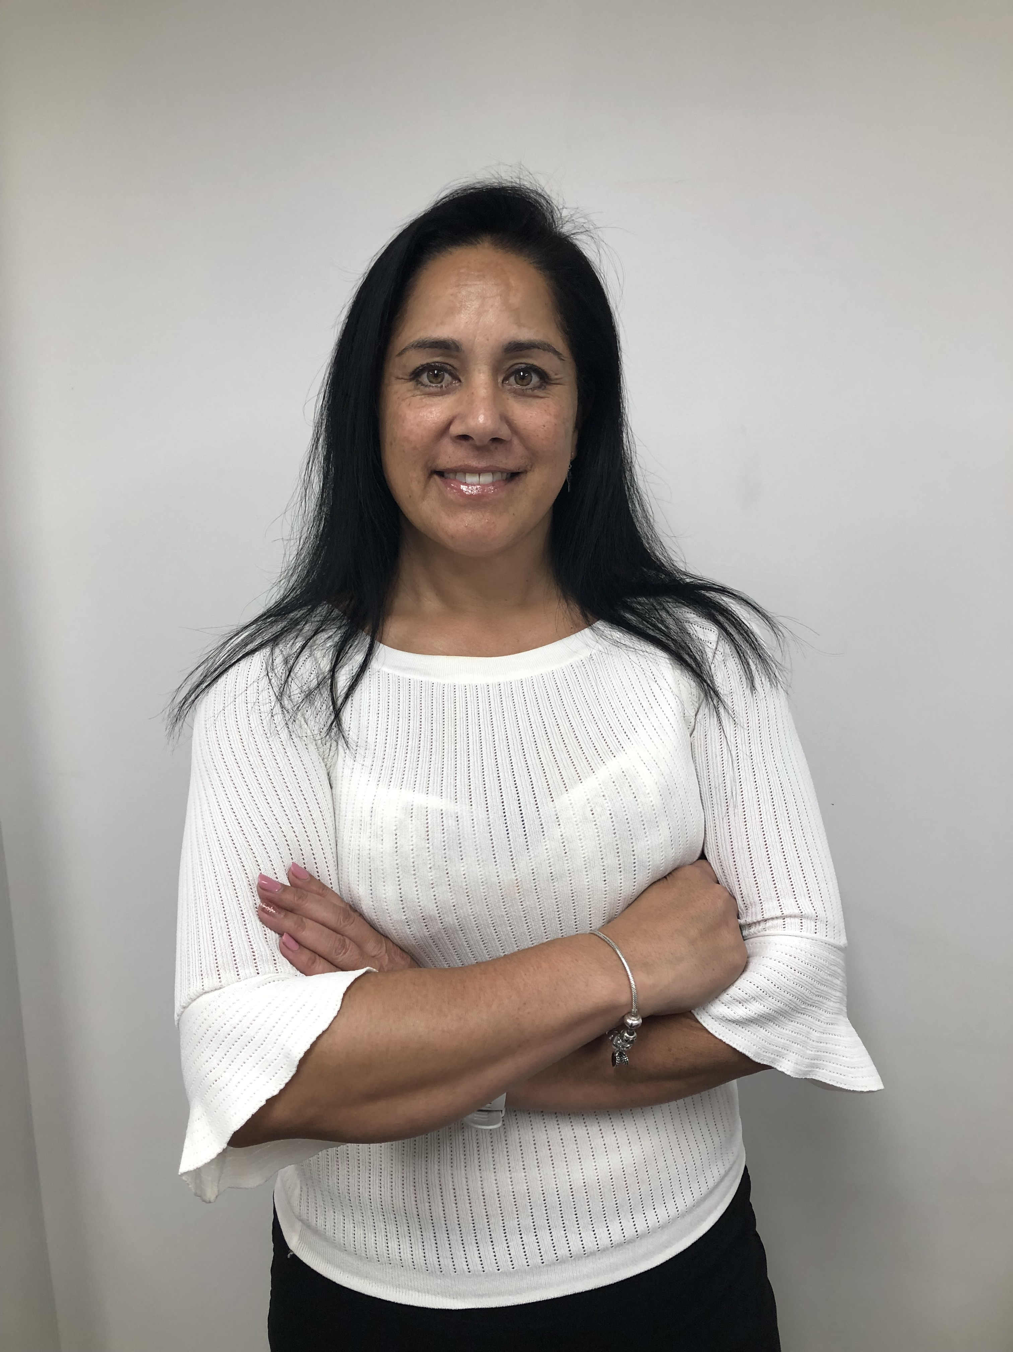
Kristina Henare Kristina@mc2ca.co.nz Client Services Co-ordinator
Your moderator today
Overseeing the running of the webinar
Notes:
My name is (Name), I’m the (Your Role) at (Firm Name) and I‘ll be your moderator today.

Slide 3
Using Zoom features
Select Audio Settings to select and test your speakers
Submit questions via Q&A button
Click Leave Meeting if you need to leave, you can rejoin using your link
Audio Settings
Chat
Raise Hand
Q & A
Leave Meeting
Notes:
For those of you who are unfamiliar with the webinar environment, these are the zoom settings, let’s take a closer look at the webinar controls.
Select Audio Settings to select and test your speakers
Submit questions via the Q&A button not through the chat. We’ll answer your questions at the end of each segment, so if you send them through I can put them to Lisa.
Click Leave Meeting if you need to leave at any time.

Slide 4
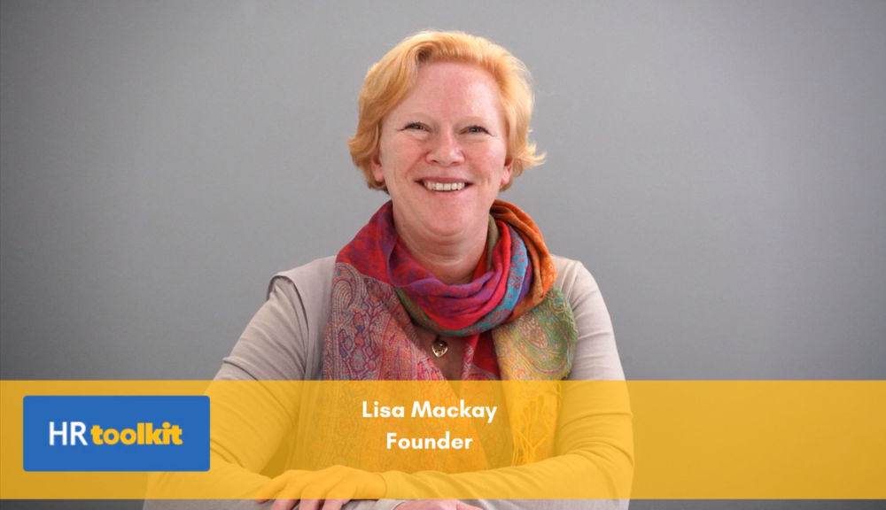
Lisa Mackay lisa@hrtoolkit.co.nz Founder: HR toolkit
Today’s panellist
Disclaimer: The information in this webinar is intended for educational purposes and is of a general nature only. It does not constitute legal or professional advice specific to your particular circumstances. We don’t make any warranty, express or implied, and don’t accept legal liability or responsibility for the accuracy, completeness, or usefulness of any information presented. We recommend contacting us or other suitable professionals for advice specific to your circumstances.
Notes:
Now I’d like to introduce todays presenter, (Name, position and relevant information)… welcome (Name)!
Give Presenter controls, mute yourself.
Check it is recording (if required). Open question bar.

Slide 5
Notes:
Thank everyone for attending and participating in the webinar and remind them to complete feedback on exit from the webinar.
Thanks for making the time to attend this webinar, we appreciate that your time is very valuable. Please complete the brief exit survey following this session so we can continuously improve and get your feedback on what other webinar topics you’d like to see from us.
We hope we’ve given you plenty of ideas to ponder and some clear next steps for you and your business.

